Slide 1

Gradual Verification with Dafny
Eric Mercer*, Tyler Dean, and Cassidy Waldrip
Brigham Young University
Provo UT, USA
Sasha Fedchin and Jeff Foster
Tufts University
Medford MA, USA
Zvonimir Rakamaric and Robin Salkeld
Amazon Web Services

Slide 2

Designing high assurance systems is hard because failure risks reputation, safety, capital, etc.

Slide 3
Test is widely understood but only samples the input and output space which is not always sufficient for assurance

Slide 4

Formal reasoning gives strong assurance through proofs of correctness but requires expertise that is not common
Notes:
Gradual verification follows. Introduce the example and show the gradual verification.
How do you move from formal traditional test dev to formal reasoning.

Slide 5
Formal reasoning in Dafny
High Assurance Method
Inputs
Requires
Implementation
S₀, S₁, …
Ensures
Outputs
Hoare Triple
When requires are met, implementation establishes ensures
All loops in implementation terminate
The contract (requires and ensures) are a sound abstraction of implementation

Slide 6
Implementation
Reason hierarchically with the contract abstractions
S₀
.
.
.
S_{i}
.
.
.
S_{x}
.
.
.
Ensures must satisfy downstream requires
call method_{i}(j, …)
R_{i}
E_{i}
call method_{x}(y, …)
R_{x}
E_{x}
If it is not in the contract then it is unconstrained in the proof
Notes:
Garbage in gives garbage out.
So proving an implementation meets its contract only cares about thinks in the contract and nothing else.

Slide 7
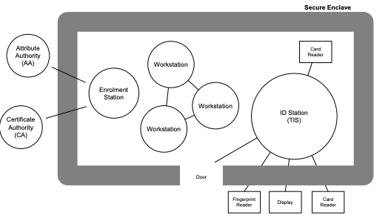
Access control with Tokeneer
Notes:
An Enrolment Station is used to issue a token to an approved user.
The Tokeneer ID Station (TIS) is a stand-alone “trusted” entity responsible for performing biometric verification of the user. To perform this task it makes use of the biometric information in the I&A Certificate on the user’s token and a fingerprint scan read from the user. If a successful identification is made then, assuming the user has sufficient clearance (held on the Privilege certificate), the TIS adds a signed Authorisation Certificate to the user’s token and releases the lock on the enclave door to allow the user access to the enclave.

Slide 8
Environment Abstraction
class {:extern} Fingerprint {}
Define interfaces for existing components not being modeled
class {:extern} SecurityClearance {
predicate method {:extern}
isCleared(level : SecurityClearance)
}
class {:extern} Token {
predicate method {:extern} doesCertify(f : Fingerprint)
function method {:extern} getLevel() : SecurityClearance
}

Slide 9
class IdStation {
var alarm : bool;
var level : SecurityClearance;
method hasAccess_(t : Token, fingerprint : Fingerprint)
returns (hasAccess : bool)
requires !this.alarm
modifies this`alarm
ensures alarm == (!t.doesCertify(fingerprint))
ensures hasAccess ==
(!alarm && level.isCleared(t.getLevel()))
}
Object state (additional input)
Contract
Notes:
Create an internal method to define the behavior of hasAccess.

Slide 10
Implementation
var doesCertify : bool := t.doesCertify(fingerprint);
if (doesCertify) {
var tokenLevel : SecurityClearance := t.getLevel();
hasAccess := level.isCleared(tokenLevel);
} else {
alarm := true;
hasAccess := false;
}
Dafny proves the contract is a sound abstraction but
Is the contract correct?

Slide 11
Top-level Interface
method hasAccess(t : Token, fingerprint : Fingerprint)
returns (hasAccess : bool)
modifies this`alarm
ensures alarm == (alarm || !t.doesCertify(fingerprint))
ensures hasAccess ==
(!alarm && level.isCleared(t.getLevel()))
{
expect !this.alarm;
hasAccess := hasAccess_(t, fingerprint);
}
Contract
Runtime check to guard requires
Code
Dafny proves the contract abstraction but
is the contract correct?

Slide 12

Notes:
Shell game because the fundamental issue has not gone anywhere, a model needs to be created and there needs to be some way to give assurance that the model is correct for some definition and that the actual implementation is faithful to the model. The fundamental problem is still there.
And there are new challenges: specifications can be complex and just as hard to write as the implementation and they use a formalism that is not always familiar leading to some common mistakes: unconstrained behavior or inconsistent specification.
The different though is that there are now two statements about what a component does: a specification _and_ an implementation. The tests should pass on both statements, so this differential tests over two ways to say the same thing increases assurance that what is written is what is wanted and what is generated and the proof certificate actually means something worthwhile.
The solution is test. Again. Write tests that build assurance that the specification says what it needs to say.

Slide 13
requires req ==> (Historically(!req) || Since(!req, rsp))
ensures isPending == Since(!rsp, req && !rsp)
ensures latency == (if req then 0 else old(latency) + 1)
ensures policy ==
((isPending ==> latency < MAX_LATENCY) &&
(rsp ==> (req || old(isPending))))
ensures alert == ((isLatched && old(alert)) || !policy)
ensures alertEvent == alert
ensures if (!alert && rsp)
then outputEvent && output == response
else !outputEvent
Contracts can be nonobvious and have defects
like typos, bad logic, subtle unexpected behavior, etc.
just like code
Notes:
Contracts get really complicated really quickly. And it is not ever intentionally.
Even though a property seems easy to say, it sometimes ends up be not so easy in the specification language.
The contract can be as complicated, or more complicated, than the implementation.

Slide 14
Common Unintended Subtleties in Contracts
FALSE
requires f(i₀,…)
Precondition is a contradiction
FALSE
requires f(i₀,…) ==> h(i₀,…)
Vacuity and under specification
ensures o_{i} == g(i₀,…,o₀,…,o_{i},…)
Refers to o_{i} not old(o_{i})
FALSE
ensures f(i₀,…,old(o₀),…)
Vacuity: assume(false)
FALSE
ensures f(i₀,…) ==> h(i₀,…, old(o₀),…)
Vacuity and under specification
Notes:
These issues are not obvious without having that prior expertise having worked with formal reasoning.
No calling context ever satisfies pre-condition
Can be vacuously satisfied leaving anything in h unconstrained unless there is something for !f
Common, frustrating issue, refers to some output in the pre-state when it should be in the post-state. Statically checked for self-references but not so for others because post-state may be what is wanted!
Very pernicious because the ensures form a contradiction making it so anything can be proved about outputs: false => doesn’t matter because its vacuously true.
Again can be vacuously true if !f is not somewhere.

Slide 15
Gradual Verification
Contract Model
Test
Code
Dafny
Runtime
Environment Models
Component Model
Dafny Component
Existing
Environment
Dafny Compiler
Generalized Properties
Tests
Dafny Tests
Requires a test framework for Dafny

Slide 16
Black Box Input Partitioning Tests
Inputs: this.alarm, this.level, t, fingerprint
expect !alarm
ensures alarm == (alarm || !t.doesCertify(fingerprint))
ensures hasAccess == (!alarm && level.isCleared(t.getLevel()))
1
alarm is true and any level, t, and fingerprint
2
alarm is false, any level, and t does not certify fingerprint

Slide 17
Inputs for
1
alarm is true and any level, t, and fingerprint
static method {:synthesize "fresh"}
freshIdStation() returns (idStation : IdStation)
ensures fresh(idStation)
"fresh” creates new object so its fields can be accessed directly
Notes:
Dafny may or may not define a zero argument constructor.
The Dafny compiler though always creates a zero argument constructor.
“fresh” uses that zero argument constructor in the target runtime to return the new instance.
Dafny only needs the contract for its reasoning and relies on no constructor.

Slide 18
Inputs for
1
alarm is true and any level, t, and fingerprint
static method {:synthesize "mock"}
freshSecurityClearance() returns (securityClearance : Token)
ensures fresh(securityClearance)
static method {:synthesize "mock"}
freshToken() returns (token : Token)
ensures fresh(token)
static method {:synthesize "mock"}
freshFingerprint()
returns (fingerprint : Fingerprint)
ensures fresh(fingerprint)
”mock” is a true mock and only its interface is available
Behavior unconstrained by default
Notes:
Dafny may or may not define a zero argument constructor.
The Dafny compiler though always creates a zero argument constructor.
“fresh” uses that zero argument constructor in the target runtime to return the new instance.
Dafny only needs the contract for its reasoning and relies on no constructor.

Slide 19
Test for
1
alarm is true and any level, t, and fingerprint
method {:test ”halts"}
should_throwException_when_alarmIsAlreadySet()
{
var idStation : IdStation := freshIdStation();
var level : IdStation := freshSecurityClearance();
idStation.alarm := true;
idStation.level := level;
var token : Token := freshToken();
var fingerprint := freshFingerprint();
var hasAccess : bool :=
idStation.hasAccess(token, fingerprint);
}
Nothing to prove for bad input test
Notes:
The test in only for the runtime to make sure it is checking assumptions.
There is nothing for Dafny to prove.
The test is in Dafny so all the tests are in one place in a common framework.

Slide 20
Input for
2
alarm is false, any level, and t does not certify fingerprint
static method {:synthesize "mock"}
tokenDoesNotCertify() returns (token : Token)
ensures fresh(token)
ensures forall fingerprint : Fingerprint ::
token.doesCertify(fingerprint) == false
Defines interface behavior for the mock

Slide 21
Test for
2
alarm is false, any level, and t does not certify fingerprint
method {:test}
should_alarmAndDenyAccess_when_tokenDoesNotCertifyFingerprint()
{
var token : Token := tokenDoesNotCertify();
var fingerprint : Fingerprint := freshFingerprint();
var securityClearance : SecurityClearance := freshSecurityClearance();
var idStation : IdStation := new IdStation.IdStation(securityClearance);
var hasAccess : bool := idStation.hasAccess(token, fingerprint);
Assertions<bool>.assertTrue(idStation.alarm);
Assertions<bool>.assertFalse(hasAccess);
}
Dafny proves the assertions using only the contracts for the method calls

Slide 22
Assertions Library
static method {:extern} assertTrue(condition : bool)
requires condition
static method {:extern} assertFalse(condition : bool)
requires !condition
Familiar and common interface

Slide 23
White Box MC/DC Coverage Tests
var doesCertify : bool := t.doesCertify(fingerprint);
if (doesCertify) {
var tokenLevel : SecurityClearance := t.getLevel();
hasAccess := level.isCleared(tokenLevel);
} else {
alarm := true;
hasAccess := false;
}
Trivial
Trivial
1
alarm is false, any level, and t does not certify fingerprint
2
alarm is false, level does not clear t, and t does certify fingerprint
3
alarm is false, level clears t, and t does certify fingerprint

Slide 24
Inputs to Exercise Paths
static method McDcTestIo() returns (testIo :
seq<(SecurityClearance, Token, Fingerprint, bool, bool)>)
{
// … code to create input values …
return [
(securityClearance0, token0, fingerprint0,
hasAccess0, alarm0),
(securityClearance1, token1, fingerprint1,
hasAccess1, alarm1),
(securityClearance2, token2, fingerprint2,
hasAccess2, alarm2)
];
}

Slide 25
method {:test "MethodSource", "McDcTestIo"}
should_resultInMcDcCoverage_when_givenAllTestInputs(
securityClearance : SecurityClearance,
token : Token, fingerprint : Fingerprint,
expectedHasAccess : bool, expectedAlarm : bool)
{
var idStation : IdStation := new
IdStation.IdStation(securityClearance);
var hasAccess : bool :=
idStation.hasAccess(token, fingerprint);
Assertions<bool>.expectEquals(hasAccess, expectedHasAccess);
Assertions<bool>.expectEquals(idStation.alarm, expectedAlarm);
}
Expect is only a runtime check so nothing to prove

Slide 26
Expect Runtime Check
static method {:extern} expectEquals(expected : T, actual : T)
ensures expected == actual
Dafny ensures the relation

Slide 27
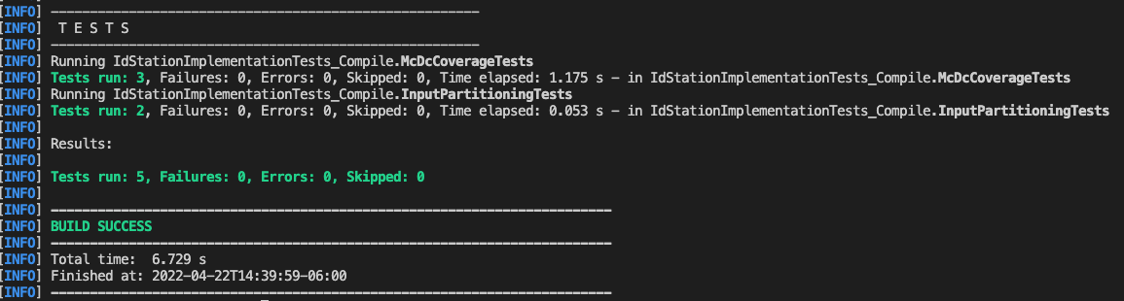
Dafny Cross Compiles Tests to Java and C#
JUnit 5 and Mockito (Java) and XUnit (C#)
Direct mapping from Dafny to test framework

Slide 28
What is next? Automatic Test Generation
B₀:
b₀ := true
…

